Slide 1
Chapter Four
Quality Attributes
By: Abenezer Fantu

Slide 2
Quality Attributes
Architect’s life is spent designing software systems to meet a set of quality attribute requirements.
informally called an application’s “-ilities”.
part of an application’s nonfunctional requirements.
“The application must be scalable”. Defining which of these scalability measures must be supported by the system is crucial from an architectural perspective.
It must be possible to scale the deployment from an initial 100 geographically dispersed user desktops to 10,000 without an increase in effort/cost for installation and configuration.
Note however, that many quality attributes are actually somewhat difficult to validate and test. - common sense and experience come in.

Slide 3
Performance
Can often be readily quantified and validated : not a really big problem.
The amount of work an application must perform in a given time, and/or deadlines that must be met for correct operation.
Performance usually manifests itself in the following measures:
A - Throughput
B - Response time
C - Deadlines

Slide 4
Performance
A - Throughput
Throughput is a measure of the amount of work an application must perform in unit time.
transactions per second (tps), or messages processed per second (mps).
B - Response time
This is a measure of the latency an application exhibits in processing a business transaction.
point-of-sale application supporting a large store.
guaranteed and average response times
For example, 95% of all requests must be processed in less than 4 s, and no requests must take more than 15 s.

Slide 5
Performance
C - Deadlines
weather forecasting system that took 36 h to produce the forecast for the next day! : performance deadline
transaction, request or message
no generic workload measure, it depends entirely on what work the application is doing.
be precise about the exact workload or transaction mix, defined in application specific terms, that you’re signing up for.

Slide 6
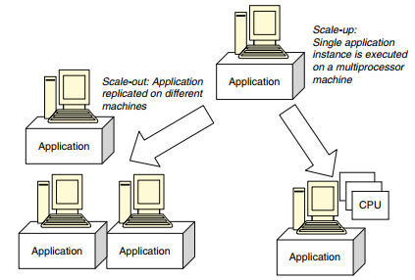
Scalability
How well a solution to some problem will work
when the size of the problem increases
How a design can cope with some aspect
of the application’s requirements increasing in size
Here are some examples: A - Request Load
A scalable solution will then permit additional
processing capacity to be deployed to
increase throughput and decrease response time. - adding more CPUs and
distributing the application on multiple machines (scale out).

Slide 7
Scalability
B. Simultaneous Connections : An architecture may be designed to support 1,000 concurrent users. How does the architecture respond if this number grows significantly.
C. Data Size : In a nutshell, how does an application behave as the data it processes increases in size?
How well will the architecture react if the size of messages grows significantly? (Chat room )
D. Deployment : How does the effort involved in deploying or modifying an application to an increasing user base grow?
This would include effort for distribution, configuration and updating with new versions.
Automated mechanisms that can dynamically deploy and configure an application to a new user,
capturing registration information in the process.

Slide 8
Modifiability
The more flexibility that can be built into a design upfront, then the less painful and expensive subsequent changes will be
how easy it may be to change an application to cater for new functional and nonfunctional requirements.
Then, assessing modifiability requires the architect to assert likely change scenarios that capture how the requirements may evolve.
Much of the time though, possible modifications will need to be elicited from application stakeholders, and drawn from the architect’s experience.

Slide 9
Modifiability
Finally, based on cost, size or effort estimates for the affected components, some useful quantification of the cost of a change can be made.
If a likely change appears difficult and complex to make, this may highlight a weakness in the architecture that might justify further consideration and redesign.
While loosely coupled, easily modifiable architectures are generally
“a good thing”
Working closely with stakeholders can help elicit highly likely future requirements, and eliminate those which seem highly unlikely.

Slide 10
Security
Authentication: Applications can verify the identity of their users and other applications with which they communicate.
Authorization: Authenticated users and applications have defined access rights to the resources of the system. For example, some users may have read-only access to the application’s data, while others have read–write.
Encryption: The messages sent to/from the application are encrypted.
Nonrepudiation: The sender of a message has proof of delivery and the receiver is assured of the sender’s identity. This means neither can subsequently refute their participation in the message exchange
Integrity: This ensures the contents of a message are not altered in transit

Slide 11
Security
The Secure Socket Layer (SSL) and Public Key Infrastructures (PKI) are commonly used in Internet applications to provide authentication, encryption and nonrepudiation.
Authentication and authorization is supported in Java technologies using the Java Authentication and Authorization Service (JAAS). Operating systems and databases provide login-based security for authentication and authorization

Slide 12
Availability
Availability is related to an application’s reliability
If an application isn’t available for use when needed, then it’s unlikely to be fulfilling its functional requirements.
Failures in applications cause them to be unavailable
The length of time any period of unavailability lasts is determined by the amount of time it takes to detect failure and restart the system.
automatically detect failure and restart the failed components.
Replicating components is a tried and tested strategy for high availability.

Slide 13
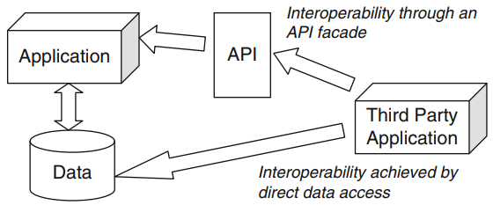
Integration
Integration is concerned with the ease with which an application can be usefully incorporated into a broader application context.
The most widespread strategies for providing integration are through data integration or providing an API.

Slide 14
Other Quality Attributes
Portability: Can an application be easily executed on a different software/ hardware platform to the one it has been developed for?
Testability: How easy or difficult is an application to test?
Supportability: This is a measure of how easy an application is to support once it is deployed.

